Slide 1


Testing with Codeception
by Hafid Mukhlasin

Slide 2
Disclaimer!
I am newbie ☺
Get this presentation : https://github.com/hscstudio/slides/JAKDIVA

Slide 3
What’s testing?
Why should we do code testing? testing dependency code
Q

Slide 4
When do we testing?
test after coding (commonly), test before coding (Test-Driven Development)
Q

Slide 5
It’s about repetitive work
Please, Don’t Repeat Yourself (DRY)
Q

Slide 6

XX Codeception
Modern PHP testing for everyone http://codeception.com

Slide 7
Testing type that we can do
Unit testing - verifies that a single unit of code is working as expected.
Functional testing - verifies scenarios from a user's perspective via browser emulation.
Acceptance testing - verifies scenarios from a user's perspective in a browser. We can test Javascript code
etc.

Slide 8
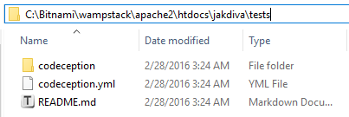
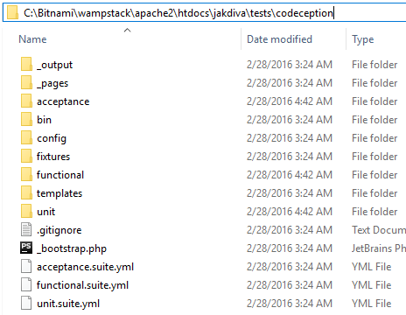
Code Testing Yii base on Codeception
its’s located in @app/test directory

Slide 9
Where we begin?

Slide 10
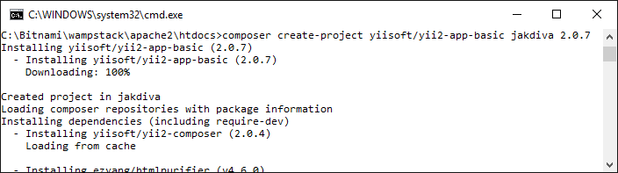
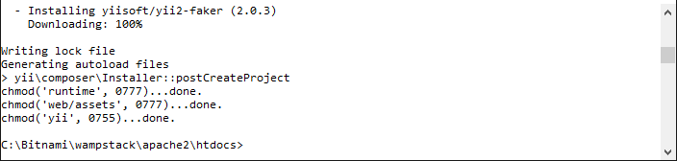
Install Yii 2.0.7
composer global require "fxp/composer-asset-plugin:~1.1.1"
composer create-project yiisoft/yii2-app-basic jakdiva 2.0.7

Slide 11
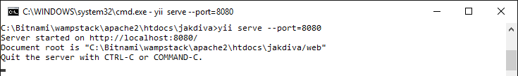
Run Built-in PHP Web Server
cd jakdiva
yii serve –port=8080

Slide 12
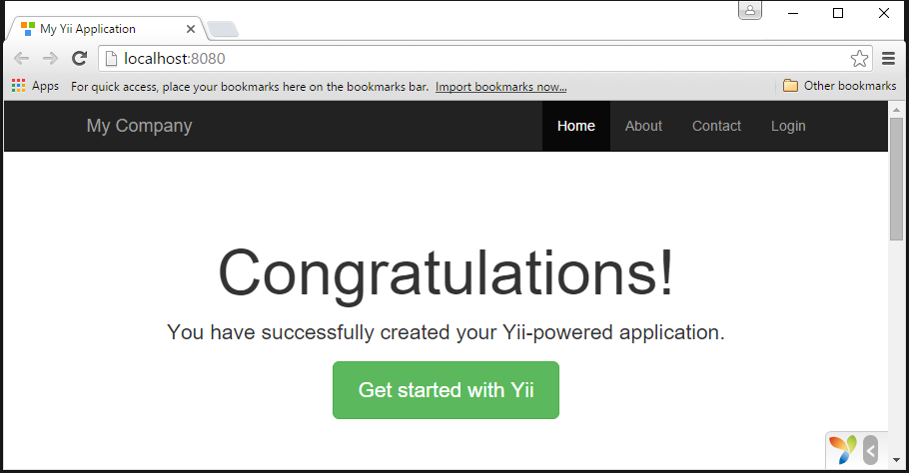
Running Yii Application
http::/localhost:8080

Slide 13
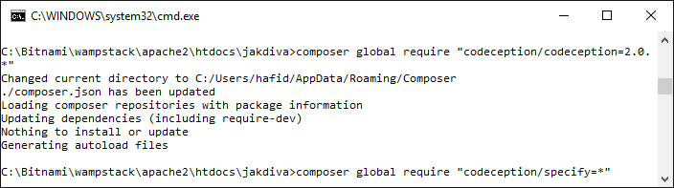
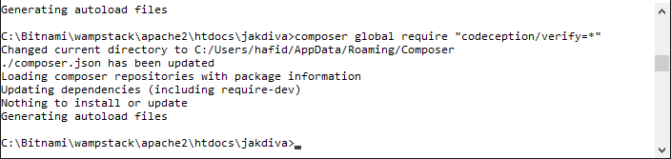
Install Codeception
composer global require "codeception/codeception=2.0.*"
composer global require "codeception/specify=*"
composer global require "codeception/verify=*"

Slide 14
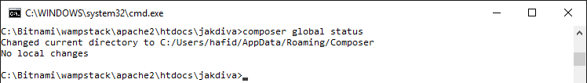
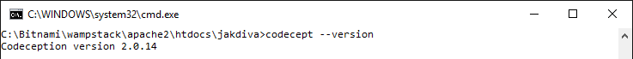
Add Directory of Codeception to Path
Check location of codeception directory
C:/Users/hafid/AppData/Roaming/Composer/vendor/bin
Add directory of codeception to Path or Global Environment Variabel
So we can run codeception only with “codecept”
composer global status

Slide 15
Codeception ready to use!

Slide 16
We can do testing
Yii have make sample of code testing

Slide 17
Part of unit testing sample
@app\tests\codeception\unit\models\LoginFormTest.php
public function testLoginNoUser() { $model = new LoginForm([ 'username' => 'not_existing_username', 'password' => 'not_existing_password', ]); $this->specify('user should not be able to login, when there is no identity', function () use ($model) { expect('model should not login user', $model->login())->false(); expect('user should not be logged in', Yii::$app->user->isGuest)->true(); }); }

Slide 18
Part of functional testing sample
@app\tests\codeception\functional\LoginCept.php
use tests\codeception\_pages\LoginPage; /* @var $scenario Codeception\Scenario */ $I = new FunctionalTester($scenario); $I->wantTo('ensure that login works'); $loginPage = LoginPage::openBy($I); $I->see('Login', 'h1'); $I->amGoingTo('try to login with empty credentials'); $loginPage->login('', ''); $I->expectTo('see validations errors'); $I->see('Username cannot be blank.'); $I->see('Password cannot be blank.');

Slide 19
Part of acceptance testing sample
@app\tests\codeception\acceptance\LoginCept.php
use tests\codeception\_pages\LoginPage; /* @var $scenario Codeception\Scenario */ $I = new AcceptanceTester($scenario); $I->wantTo('ensure that login works'); $loginPage = LoginPage::openBy($I); $I->see('Login', 'h1'); $I->amGoingTo('try to login with empty credentials'); $loginPage->login('', ''); if (method_exists($I, 'wait')) { $I->wait(3); // only for selenium } $I->expectTo('see validations errors'); $I->see('Username cannot be blank.'); $I->see('Password cannot be blank.');

Slide 20
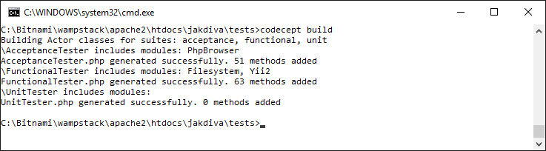
Build Test Suite
run `codecept build` to build test suite
codecept build

Slide 21
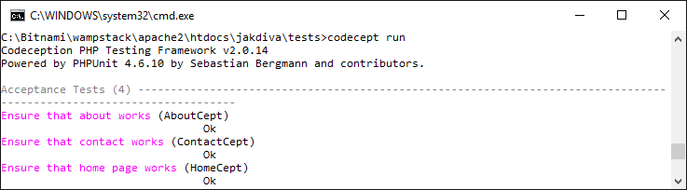
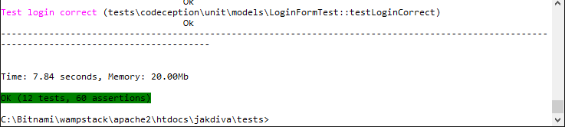
Run Testing
run `codecept run` to run 3 types testing (unit, functional, acceptance)
codecept run

Slide 22
run test per test type
codecept run unit
codecept run functional
codecept run acceptance

Slide 23
run test per file or function
codecept run unit models/LoginFormTest
codecept run unit models/LoginFormTest:testLoginNoUser

Slide 24
Install Selenium for Acceptance
http://codeception.com/docs/modules/WebDriver

Slide 25
Step By Step Installing Selenium
Download selenium http://docs.seleniumhq.org/download/
Run Selenium Server
or we can use selected browser
Enable module WebDriver @app/tests/codeception/acceptance.suite.yml
java -jar selenium-server-standalone-2.xx.xxx.jar
java -jar selenium-server-standalone-2.xx.xxx.jar -Dwebdriver.firefox.bin="D:\Program Files (x86)\Mozilla Firefox\Firefox.exe"

Slide 26
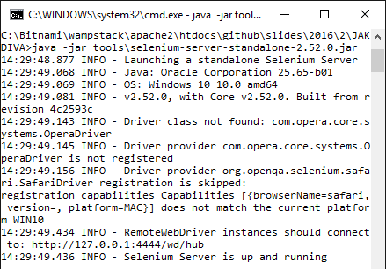
Running selenium server

Slide 27
Enable module WebDriver @app/tests/codeception/acceptance.suite.yml
modules: enabled: - WebDriver # you can use WebDriver instead of PhpBrowser to test javascript and ajax. # This will require you to install selenium. See http://codeception.com/docs/04-AcceptanceTests#Selenium # "restart" option is used by the WebDriver to start each time per test-file new session and cookies, # it is useful if you want to login in your app in each test. # - WebDriver config: PhpBrowser: # PLEASE ADJUST IT TO THE ACTUAL ENTRY POINT WITHOUT PATH INFO url: http://localhost:8080 WebDriver: url: http://localhost:8080/index-test.php browser: firefox restart: true

Slide 28
Build n Run Testing
Build Test Suite (because we enable/modify test module)
Run Acceptance Test
codecept build
codecept run acceptance

Slide 29
Any Question?

Slide 30
Thank You
hafidmukhlasin@gmail.com

